Slide 1


Interest Rate Prediction For Loans
By Danny Hua

Slide 2
Summary
Create a regression model to predict the interest rate applicants will receive. It will help applicants understand how their rate was calculated so we can advise on what they should work on in order to improve their rate if they choose to re-apply later in the future.
This is a great tool to improve customer experience and it may help save time/money trying to acquire new customers.
The Lending Club loan application data being looked at is from 2016 to 2018.
Descriptive and Inferential statistics analysis were done to identify variables to use for the regression model
Regression model produced an R-Squared of 0.447

Slide 3
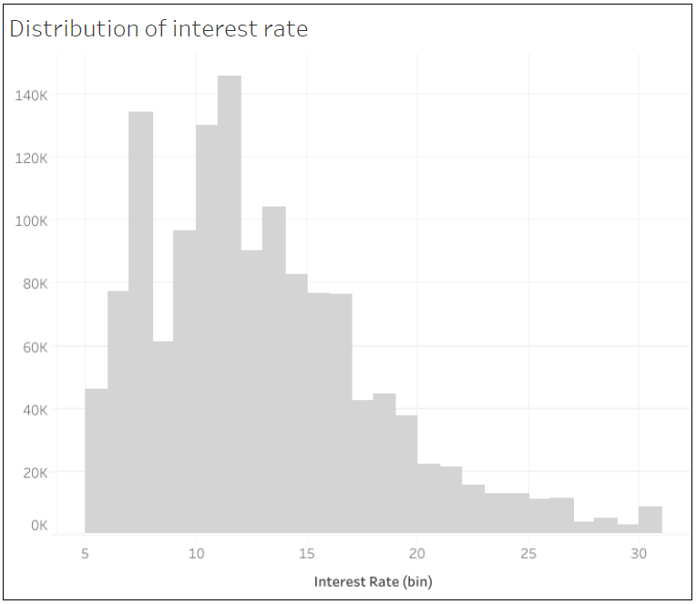
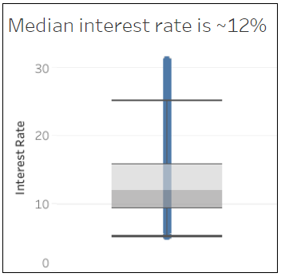
We are looking to improve customer experience for customers who may have received an offer they did not like due to high interest rate. The median rate is 12%, but there are also those who have accepted rates as high as 30%
Insights
Most of our customers have interest rate between 11% - 16%
There are applicants who accepted offers with rates as high as 30%.
Applicants with high rates are the ones we want to focus on as part of our re-targeting campaign and to improve overall customer experience.

Slide 4
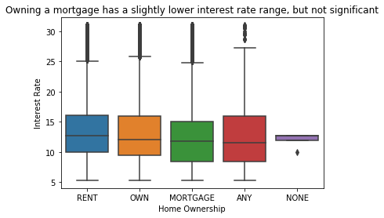
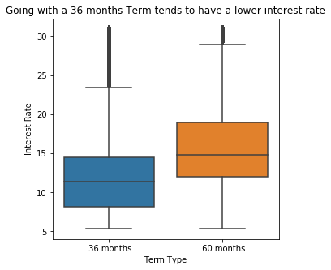
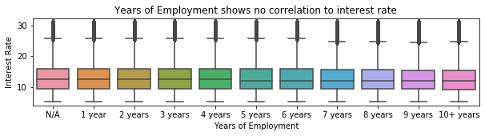
Besides from FICO score, we expected having a joint applicant, years of employment, annual income, owning a mortgage, and loan amount to be the top variables linked to interest rate, but that was not the case in this dataset.

Slide 5
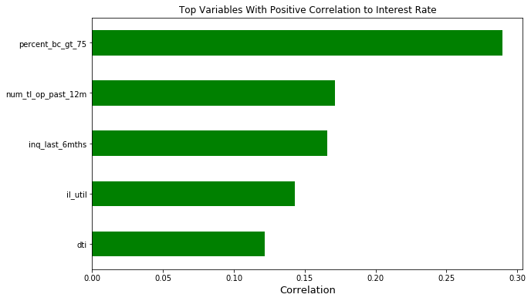
These are the top variables that showed positive correlation to interest rate. In other words these variables will lead to a higher interest rate. For example if the applicant has applied for several credit card/loans within the last 6 months, even if they are checking their rate, their interest rate tends to be higher.
percent_bc_gt_75
Percentage of all credit cards greater than 75% of limit
num_tl_op_past_12m
Total number of accounts opened in the last 12 months
inq_last_6mths
Number of inquiries in the last 6 months
il_util
Ratio of total current balance to credit limit on all installment accounts (i.e. car loan, student loan, etc…)
dti (Debt-to-Income Ratio)
Total monthly debt payments, excluding mortgage, divided by monthly income

Slide 6
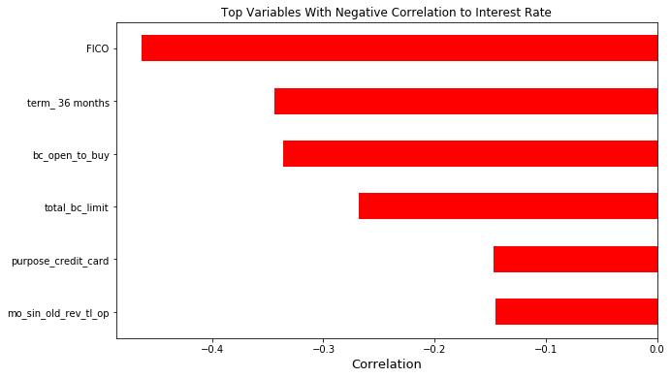
These are the top variables that showed negative correlation to interest rate. In other words these variables will lead to a lower interest rate. For example, the more credit the applicant has available for spending on all credit cards the lower the interest rate tends to be.
FICO
FICO score
term_36 months
36 Months Term loan
bc_open_to_buy
Total credit available on all revolving credit cards
total_bc_limit
Total limit on all credit cards
purpose_credit_card
Purpose of loan is to pay off credit cards
mo_sin_old_rev_tl_op
Number of months since oldest revolving account opened

Slide 7
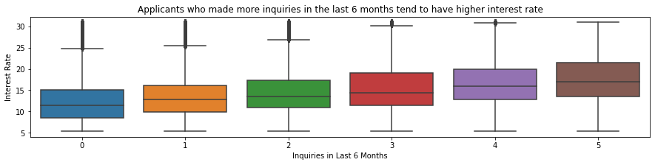
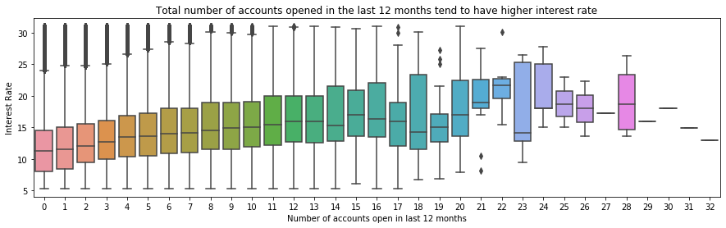
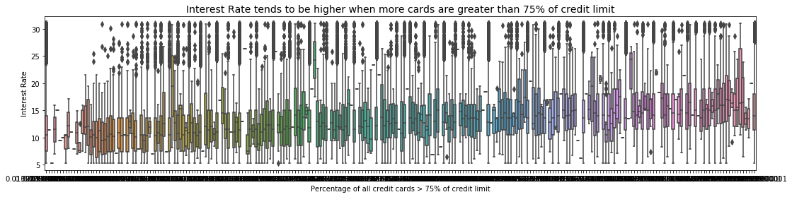
These are the top variables correlated to higher interest rate if applicants are not mindful of their activities. Our Sales Rep can advise on lowering activities on inquiries, opening accounts, and reduce utilization of credit cards if the balance is not going to be paid off immediately
Insights
Applicants should make less inquiries within 6 months of applying for a loan
Should not open too many accounts, especially credit card accounts, within 12 months of applying for a loan
For applicants with several credit cards that have utilization over 75%, they should make additional payments to quickly lower their balance to keep it below 75%

Slide 8
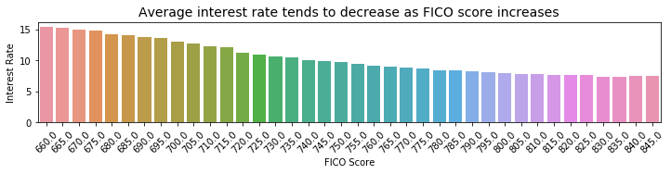
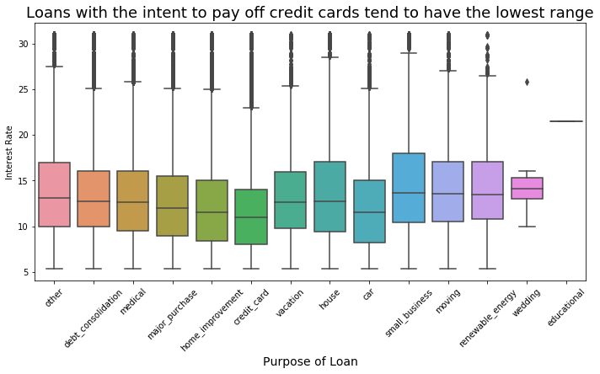
Our sales rep should advise our applicants to go with a 36 months loan opposed to 60 months with the intent to pay off credit cards. This may show a lower rate right away.
Insights
On average higher FICO scores will lead to lower interest rate
Having purpose of the loan to pay off credit card debt tends to have a lower interest rate range
Choosing a 36 Months term over a 60 Months term loan shows a significantly lower range

Slide 9
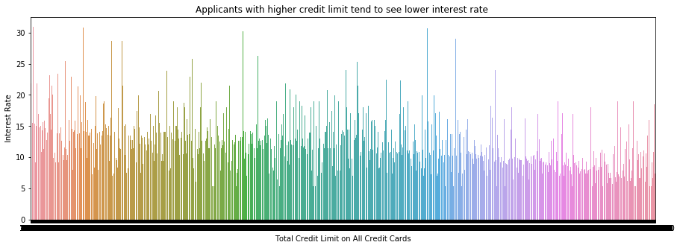
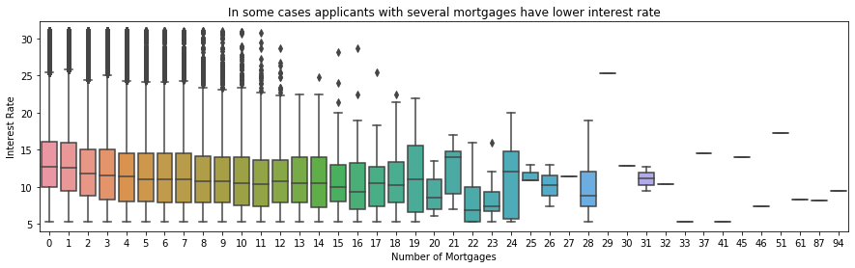
Total credit limit on all credit cards and number of mortgages also showed correlation to lower interest rate, but it would not make sense to ask out applicants to increase their credit limit by applying for more cards or apply for more mortgages. If the applicant happens to have a few mortgages it is good to inform our applicant that because they have a few mortgages it helped.
Insights
Applicants with higher total credit limit may not apply to a lot of our applicants. Having high limits may correlate to having really good FICO score.
Whether you have 1 mortgage or 0 the range is about the same. This variable may be more useful to those with several mortgages.

Slide 10
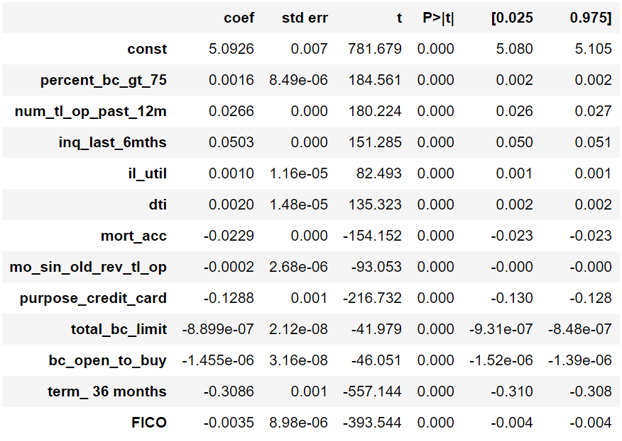
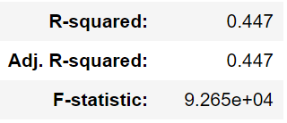
The regression model produced an R-Squared of 0.44. This is not the ideal model, but some of the variables used in this regression model can be used to help explain to our customers why their rates may be high. To improve the model, more data may be required that may not have been available or a more complex model than a regression model is required.
Conclusion:
Although the regression model is not great, we hope that this can still provide insight for the sales team. We hope that by improving customer experience, by helping our customers understand what they can improve on, it will encourage them to re-apply for a better rate.
By finding more variables and improving the model we will be able to assist our customers even more.
This tool may help save time/money trying to acquire new customers because the customers may work on areas they need to improve on and re-apply later in the future. Another test will need to be done to measure how effective this will be.

